Slide 1
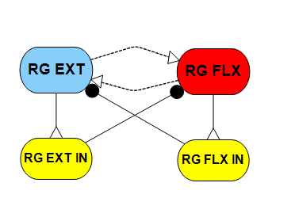


A.
$$D$$
B.
$$G_{w}$$
1.9824
4.2399
5.8619
Figure 1. (A) The rhythm generator network. D is the external drives simulate a descending command from the midbrain locomotor region (MLR); G_{w} is the synaptic conductance of the weak excitation between the oscillators.
(B) The oscillation frequencies of rhythm generator by varying G_{w} and D. There are infinite solutions for a rhythm generator with a desired frequency. (C) Neuron activations for RG driven by external drive at 1 Hz. (D) Neuron activations for RG self-oscillates at 1 Hz. (E) Neuron activities for RG driven by external drive at 1 Hz. (F) Neuron activities for RG self-oscillates at 1 Hz.
C.
D.
E.
F.

Slide 2
A.
B.
C.
D.
Figure 2. (A) The oscillation frequency can be predicted by $δ$. (B) Increases in bifurcation parameter $δ$ is done through proportional change in G_{w}$.$ (C) Phase response curves (PRCs) for various values of $δ$, when perturbed by inhibitory stimuli. (D) PRCs for various values of $δ$, when perturbed by excitatory stimuli.

Slide 3
A.
B.
C.
D.
Figure 3. (A) PRCs for varies D and G_{Syn} at 1 Hz, when perturbed by inhibitory stimuli. (B) PRCs for varies D and G_{Syn} at 1 Hz, when perturbed by excitatory stimuli. (C) PRCs for varies G_{w} and G_{Syn} at 1 Hz, when perturbed by inhibitory stimuli. (D) PRCs for varies G_{w} and G_{Syn} at 1 Hz, when perturbed by excitatory stimuli.

Slide 4
RG
1 Hz
PF
0.8-1.2 Hz
Figure 4. Connection strength between layers influence phase shifts between RG and PF. Strong connection can secure the frequency control while weak connection let the PF have more freedom to modulate timing.

Slide 5
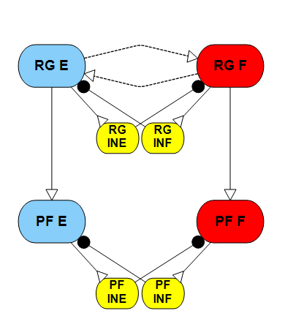




$$G_{c}$$
$$G_{c}$$
$$I_{s}$$
$$G_{c}$$
$$G_{c}$$
$$I_{s}$$

